Slide 2
THINKING OF RUNNING

Slide 3
What we will cover
Students’ Unions
Background to Students Union Elections
Roles available
Why Should I run?
Life as an Officer.
The Election Process.
How to Prepare.
Questions.

Slide 4
What is a student's union and why do we need one?

Slide 5
What is a students’ Union?
1. The Union is the representative body
Speaks on behalf of students
University and Local Community
2. The Union empowers students to organize activities & campaigns
By Students
3. The union provides services
Advice
Commercial

Slide 6
Background to students’ Union elections?
https://www.youtube.com/watch?reload=9&v=gjDwR0zcDKs&t=1

Slide 7
Why do we elect?
Selected
Objective ranking criteria
Skills and Knowledge
Experience
Selection by experts
Best fit to job
Elected
Subjective ranking criteria
Representation
Democratic
Policies and Ideas
Credibility
Legal Requirement

Slide 8
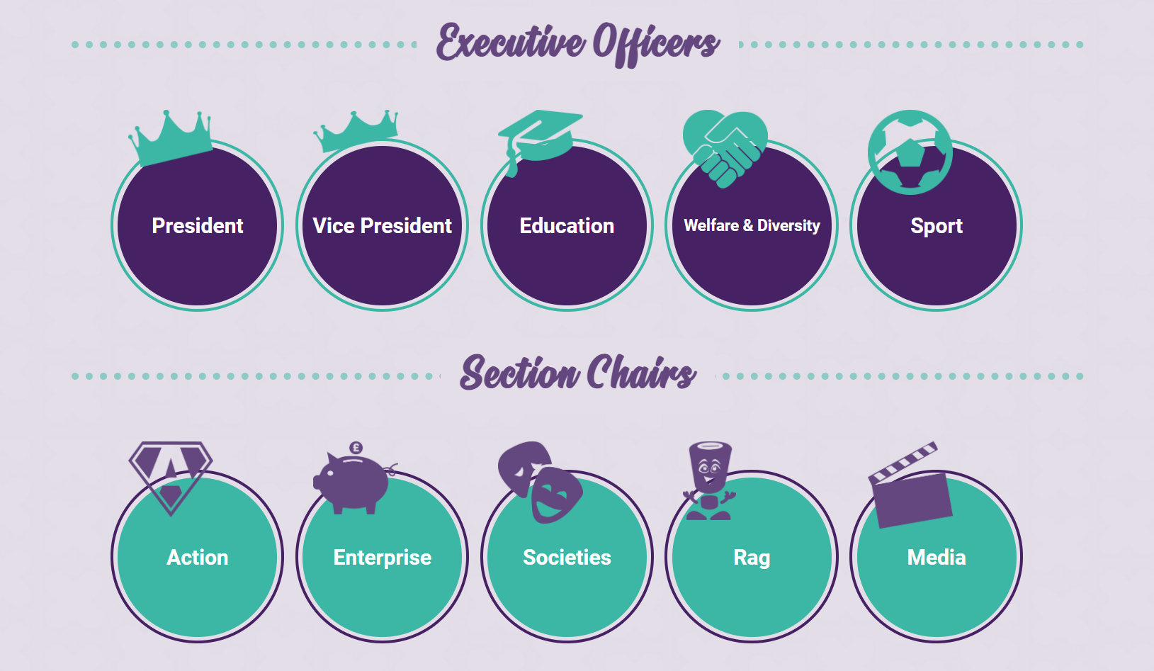
WHAT ROLES ARE UP FOR GRABS?

Slide 9
What is an Executive Officer? What is a section chair? What is the difference?
Executive Officers –
President, Vice President, Welfare and Diversity, Sport, and Education
Section Chairs –
Action, Rag, Societies, Enterprise , Media

Slide 10
Difference between Executive Officers, Section Chairs and Staff
Executive Officers
Trustee
Lead
Represent
Section Chairs
Lead
Represent
Staff
- Manage
- Support

Slide 11
Why should you stand?
Why you should stand:
Ability to make a difference and support the delivery of the UK’s best student experience
Opportunity to gain experience in a role far more senior than any other at this stage in your career
Gain experience in event and/or strategic planning
Work in an environment that will support you to succeed
To develop people skills such as negotiating and influencing
You love Loughborough
The employment bit:
All of our paid Executive Officer and Section Chairperson roles fall in line with LSU’s broader HR and employment policies.
The salary is £19,612p/a
Full training is provided
A full handover from your predecessor will be provided.
You will be entitled to 20 days paid annual leave and Health Shield benefits.
Induction planned from 13th July – 2nd August

Slide 12
“OFFICERS IN ACTION”
In 2018, Joel Brocklehurst, then Action Executive Officer, began a partnership with the amazing charity, Toys on the Table, which provided toys to disadvantaged children during the Christmas period. Since its inception, over 1500 toys have been donated through the now staple Operation Jingle Bells, with 944 toys this year!
In 2009, Jamie Oliver, Rag Executive Officer, became the first head of LSU Rag to raise over 1 million pounds for charity. Every year for the next decade, each Rag chair repeated this feat solidifying Loughborough Student’s Rag as one of the most successful student funds raising groups in the country!

Slide 13
“OFFICERS IN ACTION”
In 2020, Lauren Durken then Sport Executive Officer, began work on the AU Wheelchair Basketball club which was launched the next year and served as the first Parasport club within the Athletic Union, representing a step forward in accessibility in sport at the LSU.
In 2017, Anna Milweska, then Action Executive Officer, led the Action section as they won the prestigious Queen’s Award for Voluntary Service, which is the highest possible award given to volunteer Groups in the UK. It was granted in recognition of LSU Action’s involvement in the local, national, and international community volunteering – including soup kitchens for homeless people, dog walking at local kennels, providing relief for young children or people facing disadvantage, and alleviating loneliness amongst the elderly.

Slide 14
What is Life as an officer Like?
Full Time Job (Officially 10am - 5pm)
Leading projects you are passionate about.
Leading and empowering committees and teams.
Developing your work area.
Working with university staff, union staff and people in the community.
Serving as a voice for students in different settings
University committees/groups
Community groups
National and International Conversation
Driving the Union Strategy

Slide 15
ELECTIONS PROCESS?
Nominations (26th – 30th April)
Done online at lsu.co.uk/elections.
You'll need a proposer and Seconder.
You'll need to submit a manifesto (max 250 words).
First Briefing at 7pm 30th April.
Media and Admin (May 1st and 2nd)
You need to be available in person during these dates.
Taking picture, recording videos, taking quotes
Approving budgets.
Further logistics.

Slide 16
ELECTIONS PROCESS?
Reveal (6th May)
Second briefing just before reveal
Social Media Launch
Campaign Launch
Soapbox (10th and 11th May)
In person and Live
Campaigning (6th May – 14th May )
Reach out to students
Be creative!
Stay within the rules.
Voting (11th May – 14th May)
Most votes wins!
Single Transferable Vote.

Slide 17
Single Transferrable Voting
It’s fairer
It’s more representative
It allows students to have a larger democratic say in their elected leaders
There is no danger of splitting the ballot if 10 candidates stand against 1 super popular person.
https://www.youtube.com/watch?v=N_-C9Fwrg_A

Slide 18
How is this year different To Previous Years
Covid-19!!!
Wholly digital election
Poster, banners and boards disallowed, but the Union will be producing and distributing these.
No night-out campaigning

Slide 19
FREE AND FAIR ELECTIONS
LSU is bound by law to run a free and fair election.
There are a number of rules and regulations, enforced by an external ‘Returning Officer’ who ensures Election is run fairly and smoothly
This is done through deputies and officials - (Acting Returning Officer, Elections Sub-Committee)
If you deliberately circumvent the rules you will be disciplined or disqualified.
Election fraud could see the entire election result(s) overturned.

Slide 20
HOW TO PREPARE
Get your campaign team together
Proposer and Seconder
Active Contributors
Support Network
Create Your Brand!
Decide what you stand for
Communicate through manifesto
Enshrine into campaign
Plan your workload
Don't Overwhelm yourself

Slide 21
HOW TO PREPARE Cont'd
Plan your Campaign
How are you reaching out to students?
How are you spending your budget?
What events could you attend?
How will you make optimal use for your time?
Set Your Budget
Start Buying things.

Slide 22
DIGITAL CAMPAIGNING
Use Social Media
Giving Updates.
Publish Campaign Materials.
promos
Attend Virtual Events.
Ask Lecturers to attend virtual lectures.
Interesting Content.
Be creative.

Slide 23
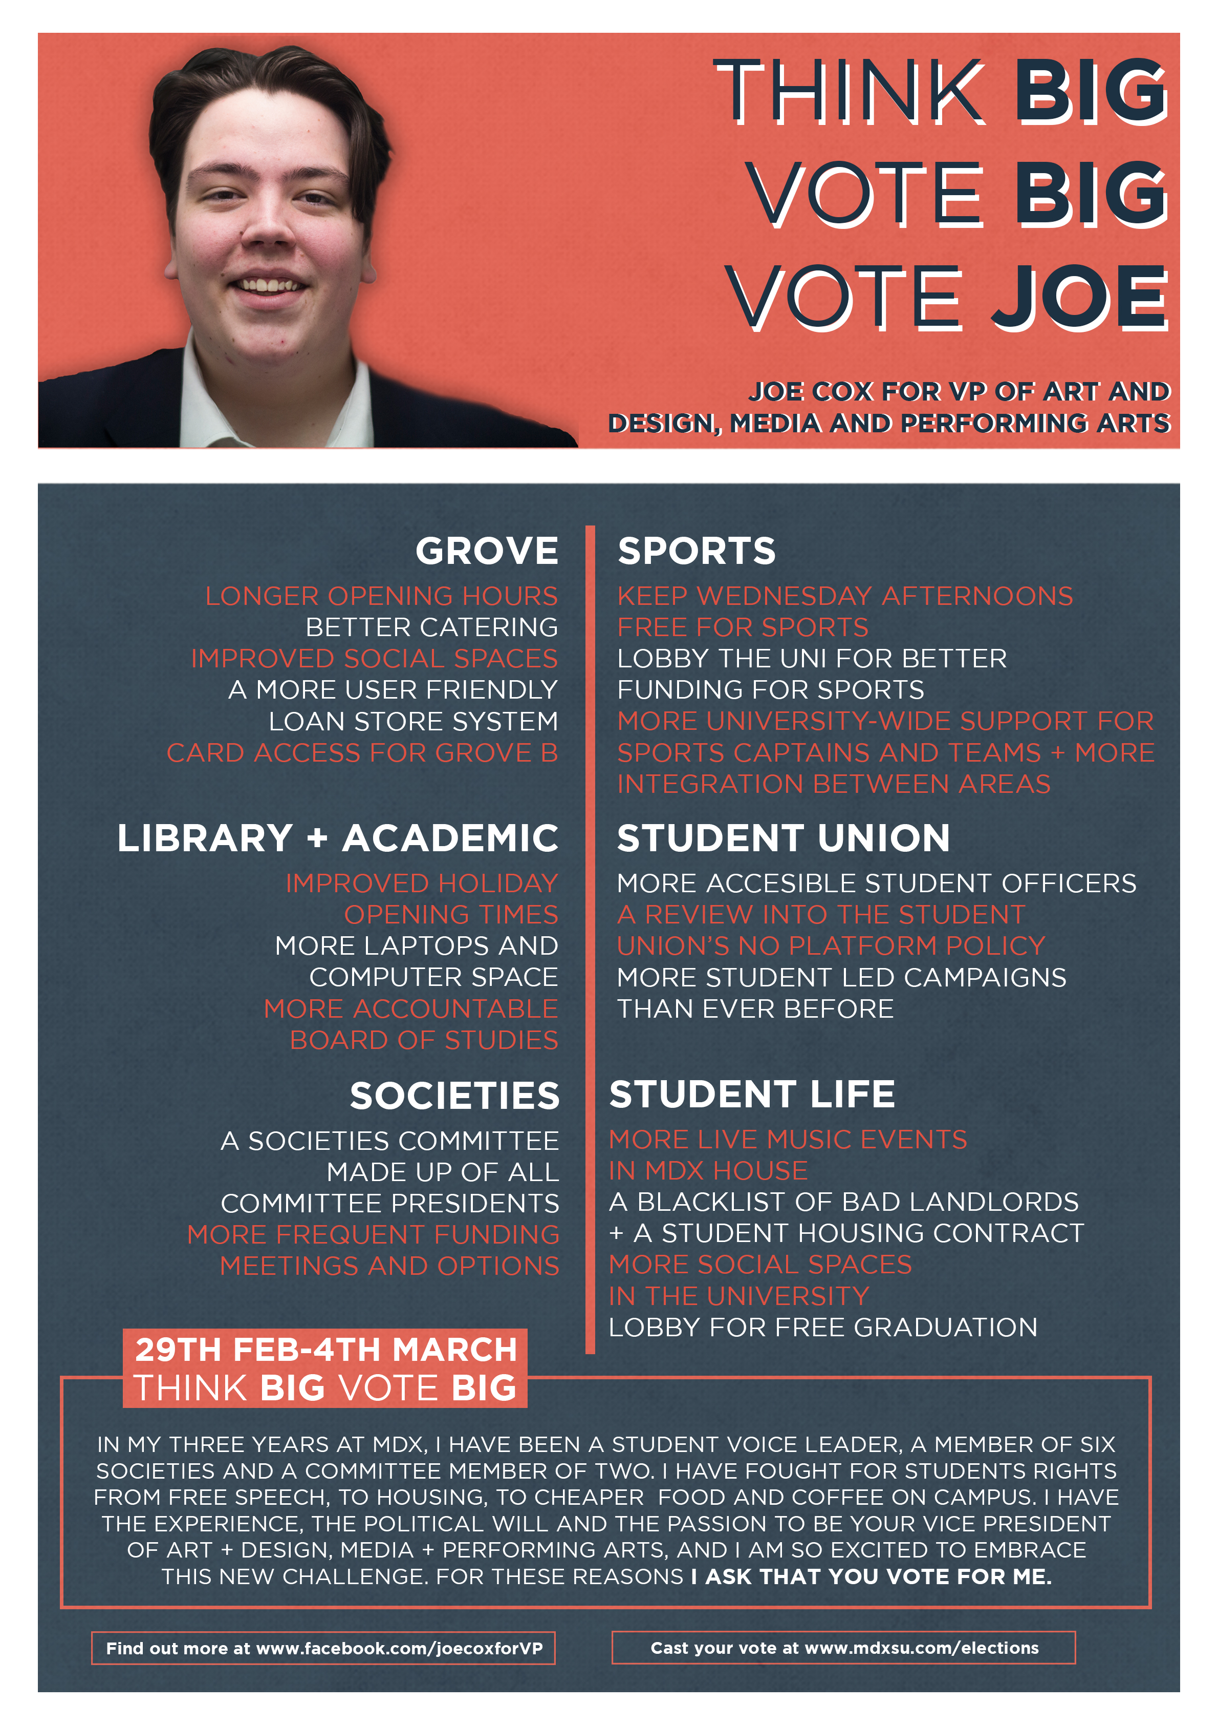
Graphics
Think about design
Consistency of message and image
Include basic info including how to vote!
Remember to include some key points!
You may choose to have a slogan
You need to be memorable

Slide 24
Why people vote
72% were asked directly
60% knew what the candidate stood for
70% had seen a poster or flyer
29% had read the manifesto
4% had read the unions publicity

Slide 25
You and your campaign team’s Wellbeing
Have fun
Be proud of yourself and your team
Hold your head high
Prepare for life after the election
Expect to win, be ready to lose.
Be a gracious winner and a good loser
Avoid negativity

Slide 26
UNION SUPPORT
Posters and banners will be designed and distributed on your behalf
The union will design targeted ad campaigns on your behalf
Soapbox
Nightly Media Shows
Publishing Campaign Materials
Bank of resources available on the website
Mental Health First Aiders on hand.
Experience Marketing staff available for advice.

Slide 27
UNION SUPPORT

Slide 28
QUESTIONS?

Slide 29
Things to know
Shadowing – all of incumbent officers are available for shadowing throughout April. Just contact them to set something up.
Publicity – You cannot inform others of your candidacy before the opening of campaigning
Social Media – you cannot release any social media before 8pm Friday 28th February
Discipline – the elections disciplinary policy will be found online at www.lsu.co.uk/ExecElections and all decisions will be made by the Acting Returning Officer. Appeals can be made to the Head of Governance.

Slide 30
The Basics of Winning Votes
Supermarkets
“I have to go food shopping to live, so supermarkets get me to choose them”
SU Elections
“I don’t vote very often – so you have to get me to vote
You will need to explain to students why they should vote, and why they should vote for you.
Be relevant
Ensure LSU delivers xxxx to more people by…
Be realistic
Beer at 10p per pint (hint: nope)
I will improve our union by…

Slide 31
Student Trust
They don’t trust:
I will listen to YOU
I want YOUR ideas
YOU are the most important thing
Putting YOU in charge
FAKE NEWS
Negative Campaigning
They listen to trust:
Having listened to students, I think
I believe
Students tell me that
I know that
What I will do is

Slide 32
Planning a campaign
Make a list of target groups
Get a team together
Think about time vs votes (for you)
Start with innovation and ideas
How do all the activities you are doing connect to each other?

Slide 33
Your campaign team
You are responsible for their actions
Gather a wide range/strong personalities
Make sure they are “on message”
Allocating responsibilities and Tasks
Make sure they aren’t just leaflet shovers
Have meetings with them
Support them, encourage them, thank them
Make sure they don’t try and dirty tricks!!!

Slide 34
Budgeting
Max Budget - £40
All spending must be declared.
Please consider making use of recycled or recyclable items
Specifics can be found within the candidates pack (2.3)

